Slide 1
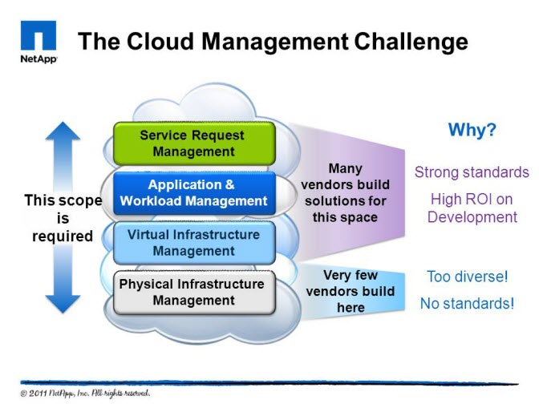
CLOUD MANAGEMENT
Unit-4

Slide 2
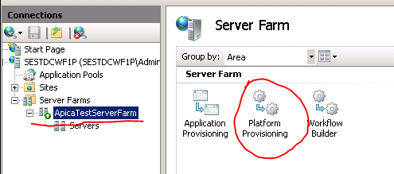

Chap:6 Cloud Management
Chapter Topics
6.1 Introduction
6.2 Resiliency,
6.3 Provisioning,
6.4 Asset management,
6.5 Cloud governance,
6.6 High availability and disaster recovery,
6.7 Charging models, usage reporting, billing and metering.

Slide 3
Cloud management
6.1 Introduction
To provide value, IT cost model has to be:
Equitable
Controllable
Repeatable and predictable
Simple
Comprehensive

Slide 4
Cloud management
6.1.1 Service- based Model
Service-based model offers cost-transparency and cost-reductions options

Slide 5
Cloud management
6.2 Resiliency
Resiliency is the capacity to rapidly adapt and respond to risks, as well as opportunities.
This maintains continuous business operations that support growth and operate in potential adverse conditions.
The reach and range step of the assessment process examines business driven, data-driven and event -driven risks.
The resiliency blueprint includes different layers- facilities, technology, applications and data, processes
The framework enables people to examine business, understand what areas of vulnerabilities that might exist and quickly pinpoint areas of concern and help them understand what actions they can take to reduce the risk associated with those areas.

Slide 6
Cloud management
6.2.1 Resiliency capabilities
The framework combines multiple parts to mitigate risks and improve business resilience
From a facilities perspective, you may need to implement power protection
from security perspective- to protect applications and data
From process perspective- you may implement identification and documentation of most critical business process
From organizational perspective- geographical diversity, backup of workstation data
From strategy and vision perspective, you would want to have a crisis management

Slide 7
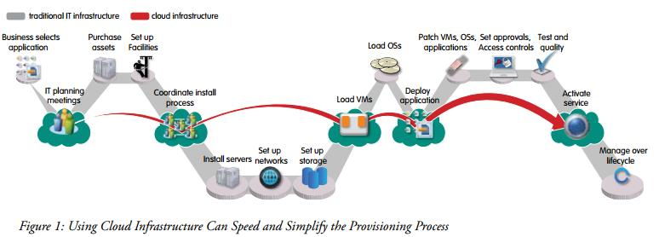
Cloud management
6.3 Provisioning
Provisioning process is a service that uses group of compliant processes called “ solution Realization”
provisioned products are servers built with all the software and infrastructure required to support a business application.
Standard solutions are defined so that standard workflows can be derived
server hardware is assembled, cabled and connected to the network and SAN before work orders are released.

Slide 8
Cloud management
6.3.1 Characteristics
Each process has the owner who is responsible for the successful implementation of the product

Slide 9
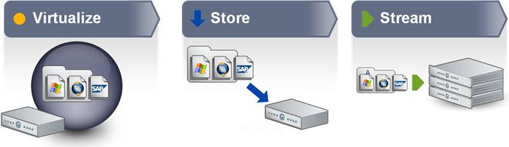
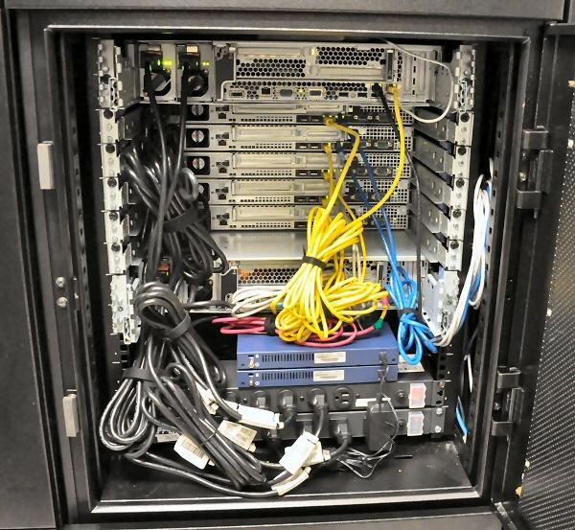
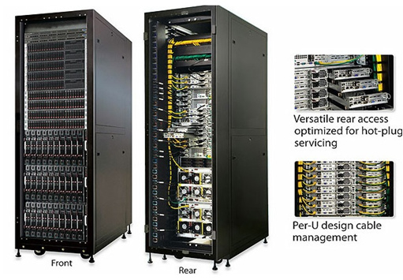
Cloud Management
6.3.1 Approach
The approach involves the following activities
Planning precedes execution
Validating build specification precede building
Packaged software installation on respective servers
Having servers racked , stacked, cabled and connected to storage and networks precedes issuing work-orders

Slide 10
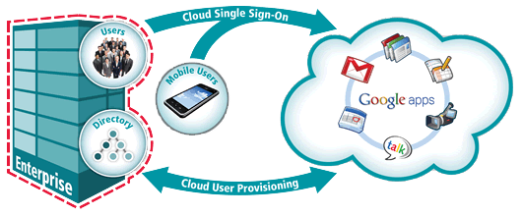
Cloud Management
6.3.3. Benefits
Here are some benefits of provisioning
ability to measure progress of all the work related to one RfS
continuous improvement activities based on process measurements
Isolation of the build, install, configure, and customise tasks from requirements design, and hardware setup activities
Role players performing a finite set of repeatable activities

Slide 11
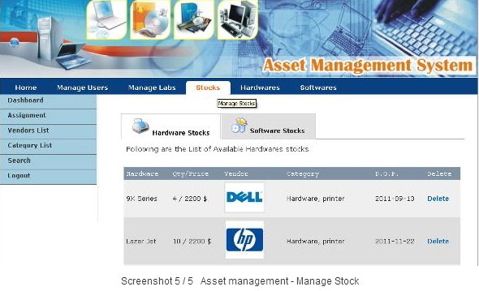
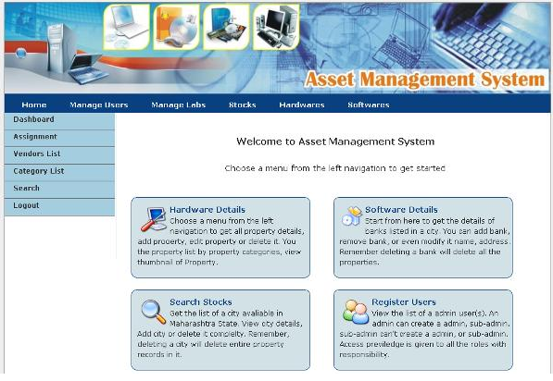
Cloud management
6.4 Asset management
Asset management and change management interact regularly. The asset management strategy includes
Software packaging
Incident management
Pool Management
Release management
configuration management
Systems management
Operational readiness Management
Backup management

Slide 12
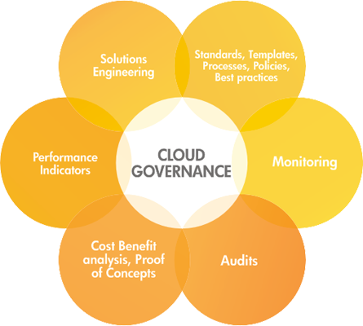
Cloud management
6.5 Cloud Governance
Cloud Governance is broken down into the following
Regulation of new service creation
Getting more use of services
Enforcing standards and best practices
Service change management and service version control

Slide 13

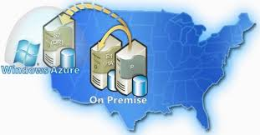
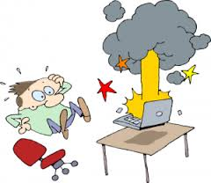
Cloud management
6.6 High availability and disaster recovery
High availability(HA) and disaster recovery (DR) are important factors for cloud deployments.
Mean time between failures
Mean time to recover
High availability
Continuous operations
Continuous availability
Availability management
Google Dashboard Gmail Outage case study

Slide 14
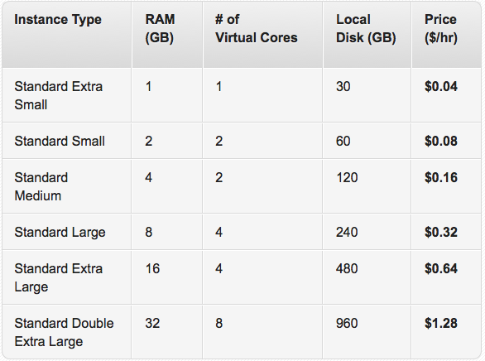
Cloud management
6.7 Charging models, usage reporting, billing and metering.
Charging models are approaches taken to recover expenses.

Slide 15
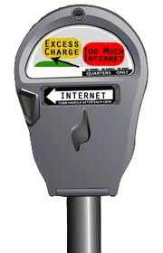
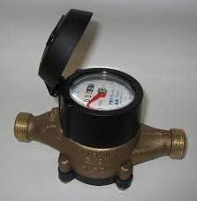
Cloud management
6.7.2 Benefits
Charging models build transparency to enterprise cost and help companies to figure out increase resources and also weed out wastes.

Slide 16
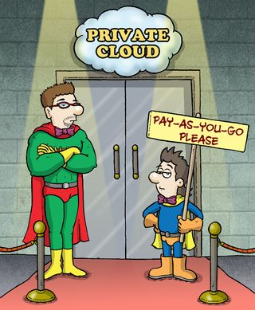
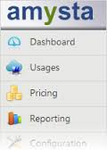
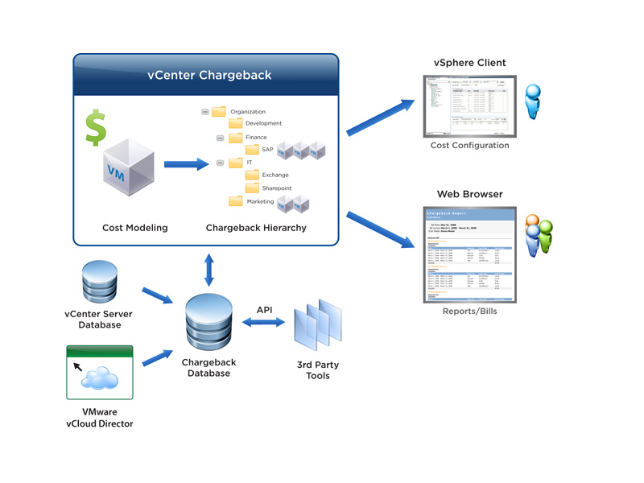
Cloud management
6.7.3 Cloud Chargeback models
Standard subscription-based model
Pay-per use model
Premium pricing model
Hybrid model
Allocation-based
Flat Fee
Usage-based
Product or service based
Activity-based
Market based

Slide 17
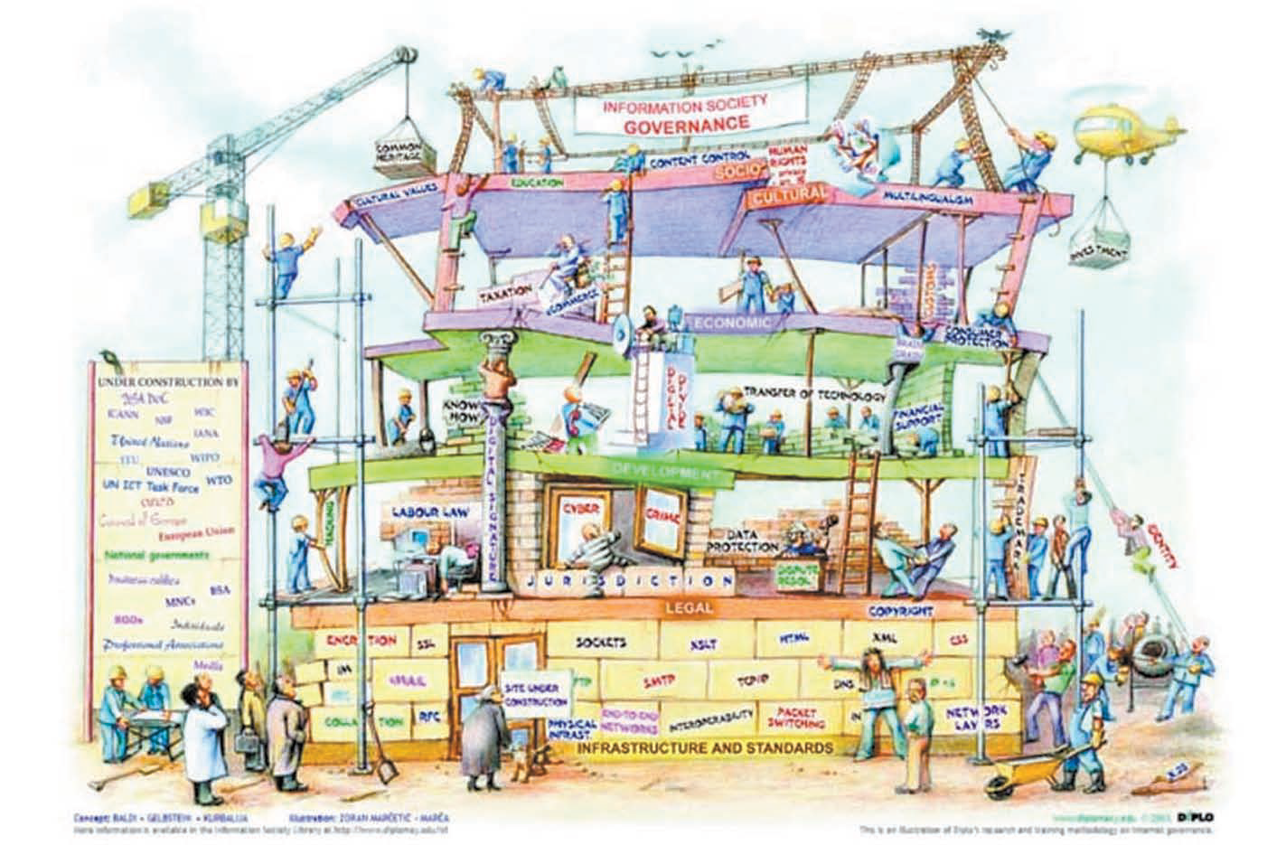
6. Cloud management
6.7.4 IT infrastructure Governance
Governance in a shared infrastructure becomes a paramount, as resources shared by all business units require some level of policies and control mechanisms that define boundaries and upload business unit requirements.

Slide 18

6. Cloud management
6.7.5 Basic Requirements
Fairness
Control
Repeatability
Simplicity

Slide 19
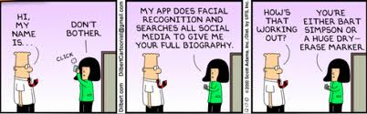
6. Cloud management
Chapter Summary
Today IT delivers technology to the business units and assesses charge based

Slide 20
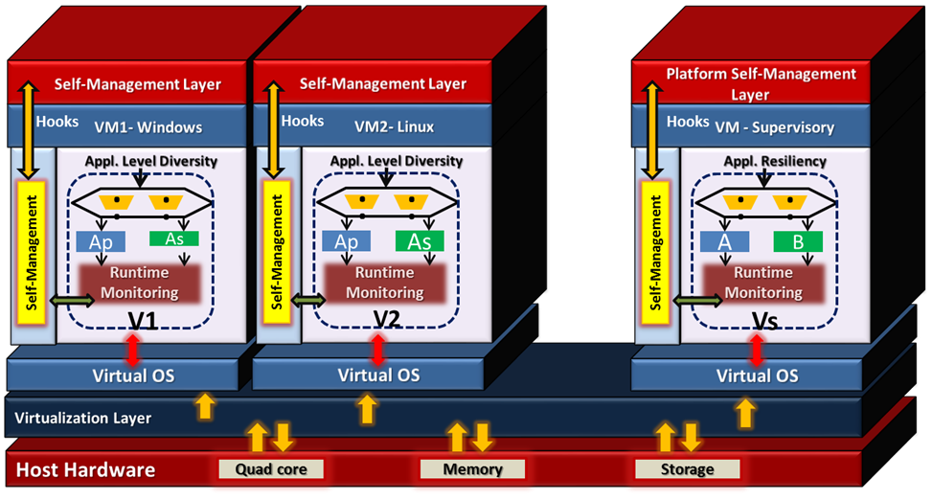

Slide 21

Thanks to -
1) Dr. Kumar Saurabh
2) http://cloudcomputing4postgraduates.blogspot.in/
3) Google Images

